Slide 1
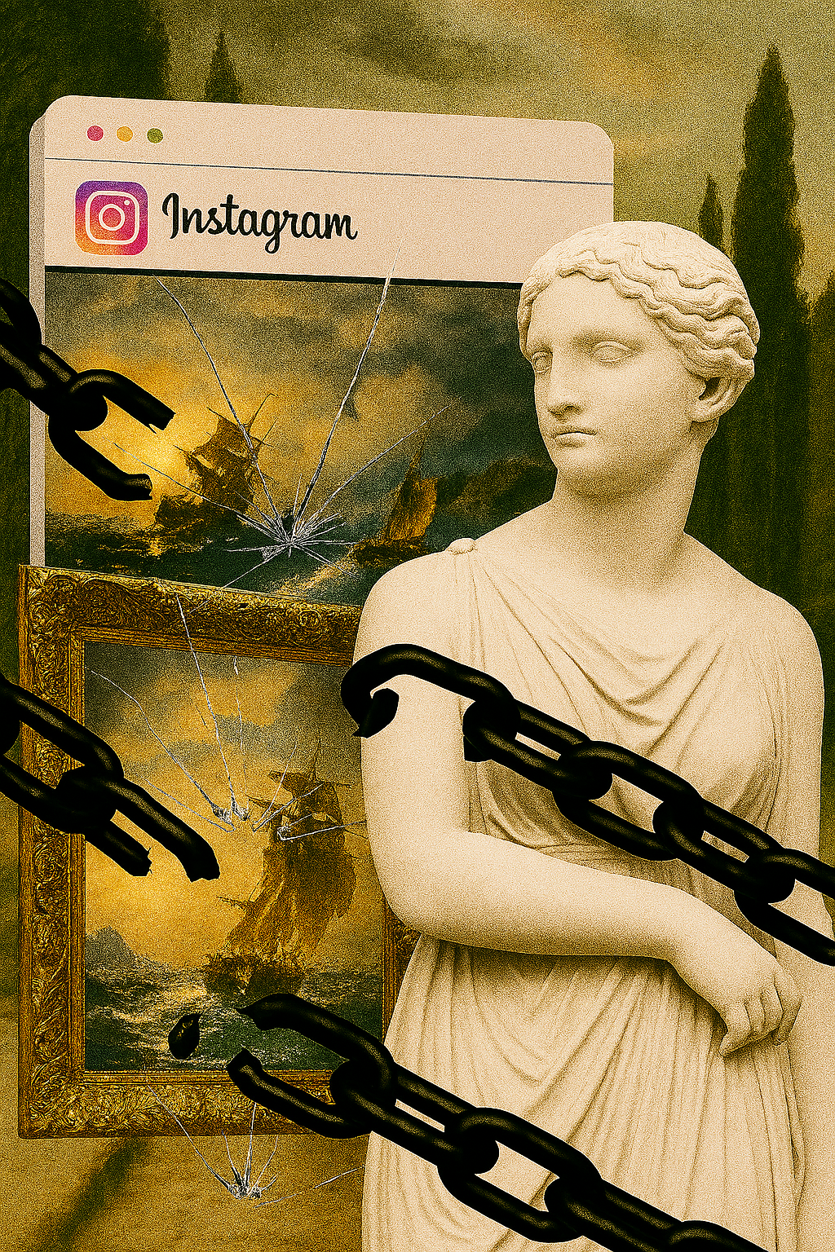


„ Born of Shocks: Catharsis of Ukrainian Art in Cultural Media Content (2022–2025)”
Visualization of Museum Decolonization and Museal Cultural Texts in Ukrainian Cultural Media on Instagram as a Manifestation of Catharsis in Ukrainian Art (2022–2025)
Institute of Slavic Studies, Polish Academy of Sciences
Dr Yana Hladyr yana.hladyr@ispan.edu.pl

Slide 2


Slide 3
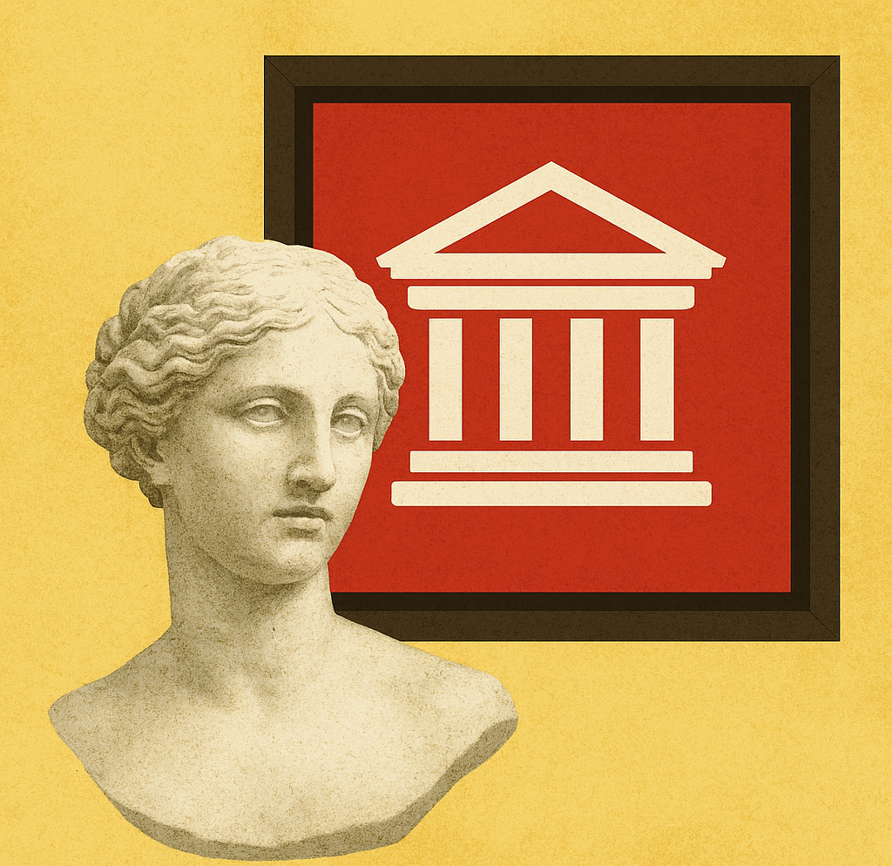
Research Hypothesis 1
Networked cultural texts published in Ukrainian cultural media present, in a contemporary way, the process of catharsis in Ukrainian art (literature, painting, cinema, music, theatre, sculpture, architecture, dance) during wartime. These texts are enriched with new meanings and capture the emergence of unique, renewed artistic forms.
Research Hypothesis 2
Phenomena of catharsis in Ukrainian art and culture emerge from the cultural fissure between East and West.
This tension generates conflictual artworks while enabling deeper insight - the consequences of conflict become central. Each cultural text and revived artistic form conveys these consequences and reveals the creative potential born of rupture.
Sevcenko, I. (1996). Ukraine between East and West. Essays on Cultural History to the Early Eighteenth Century. Edmonton -Toronto: Canadian Institute of Ukrainian Studies Press.
I apply the Aristotelian concept of “catharsis” as purification and renewal through the overcoming of tragic conflict. Conflict has long been a foundational element in the narrative of Ukrainian art. The current Russo-Ukrainian war is no exception - it serves as yet another dramatic creative impulse, triggering processes of aesthetic transformation, reflection, and renewal.
Gilbert, Allan H. “The Aristotelian Catharsis.” The Philosophical Review 35, no. 4 (1926): 301–14. P. 314 https://doi.org/10.2307/2178979.

Slide 4
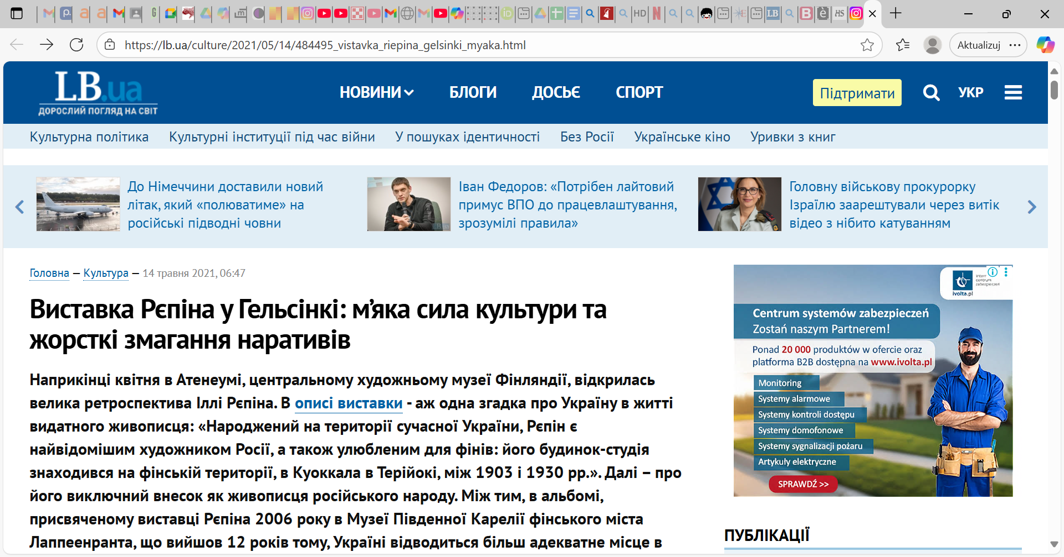
Виставка Рєпіна у Гельсінкі: м’яка сила культури та жорсткі змагання наративів - портал новин LB.ua

Slide 5
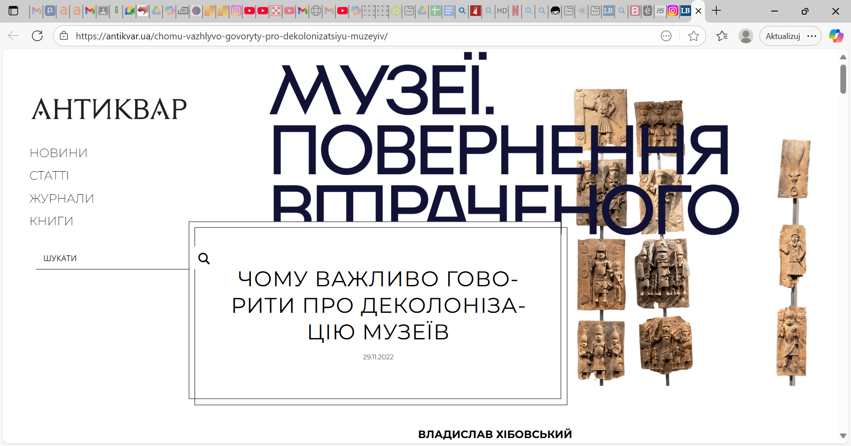
ЧОМУ ВАЖЛИВО ГОВОРИТИ ПРО ДЕКОЛОНІЗАЦІЮ МУЗЕЇВ | Антиквар

Slide 6
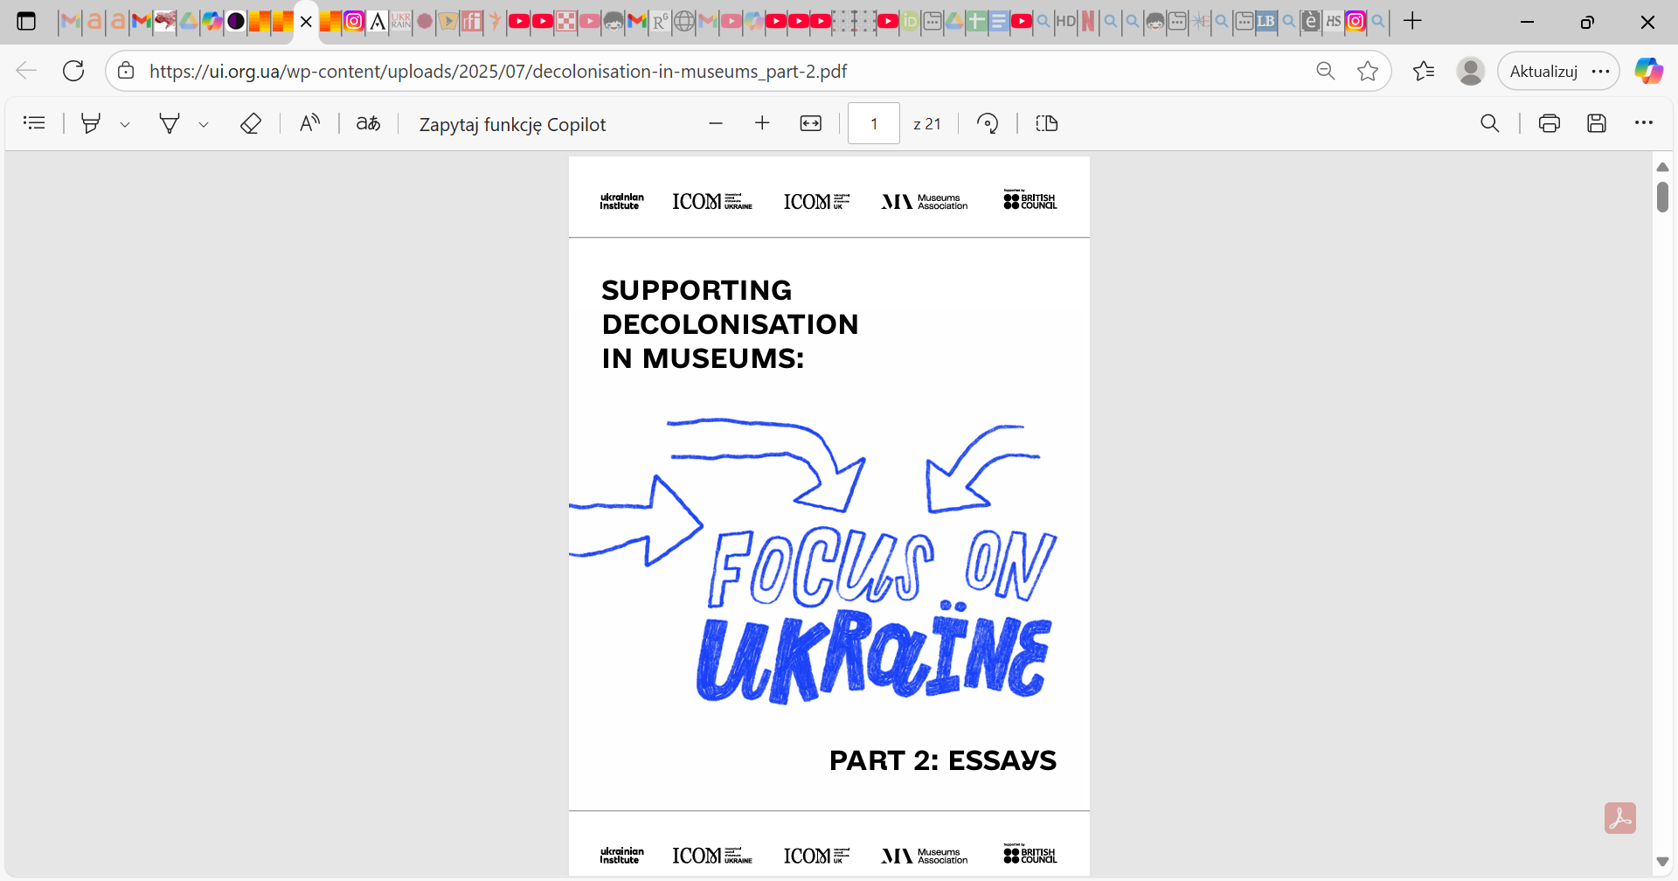
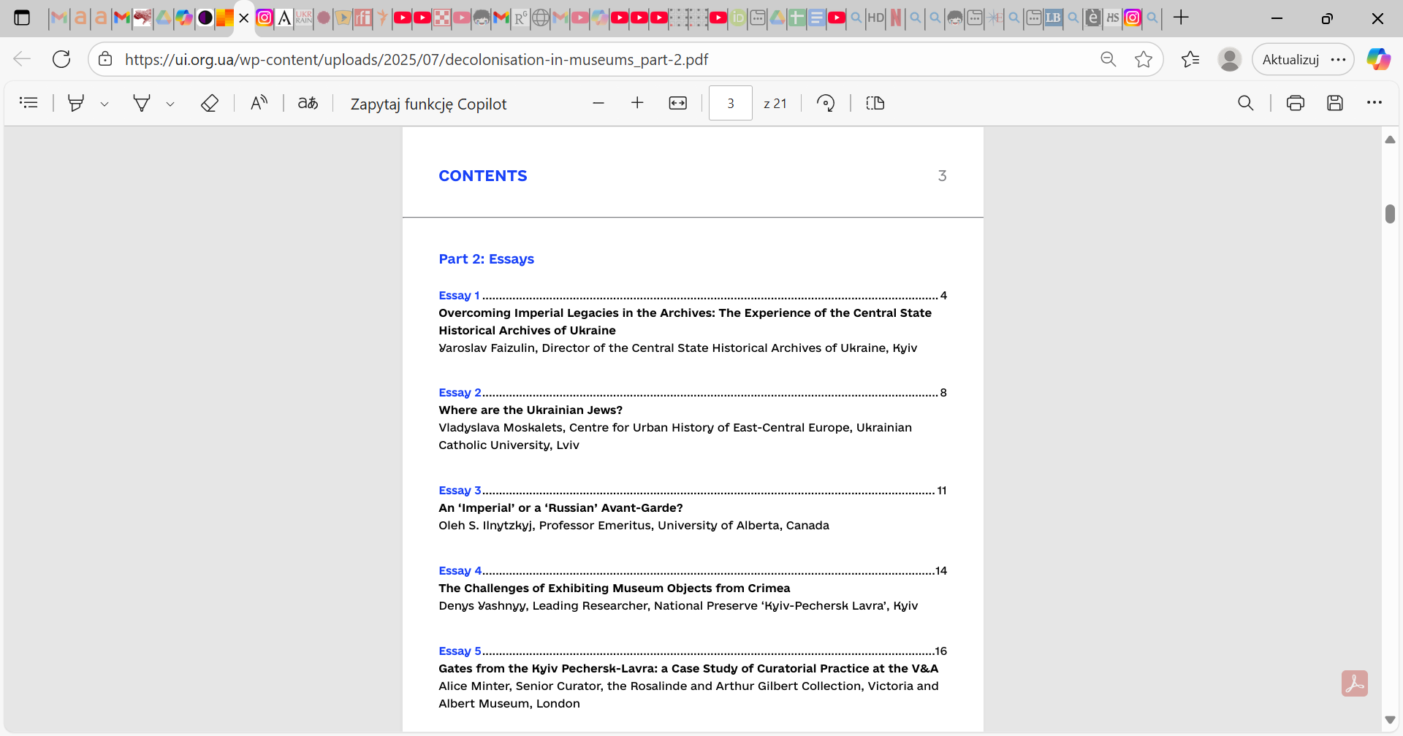
decolonisation-in-museums_part-1.pdf
decolonisation-in-museums_part-2.pdf

Slide 7
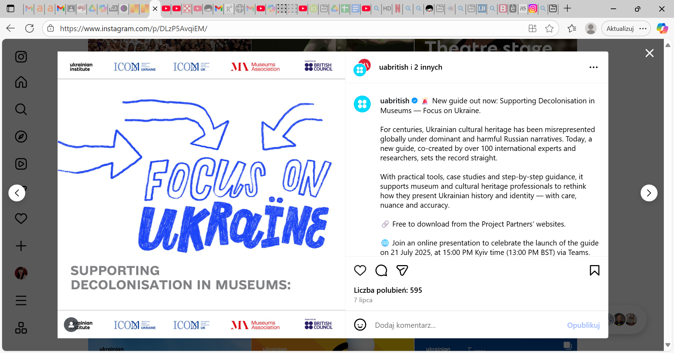
https://www.instagram.com/p/DLzP5AvqiEM/?utm_source=ig_web_copy_link&igsh=MzRlODBiNWFlZA==

Slide 8
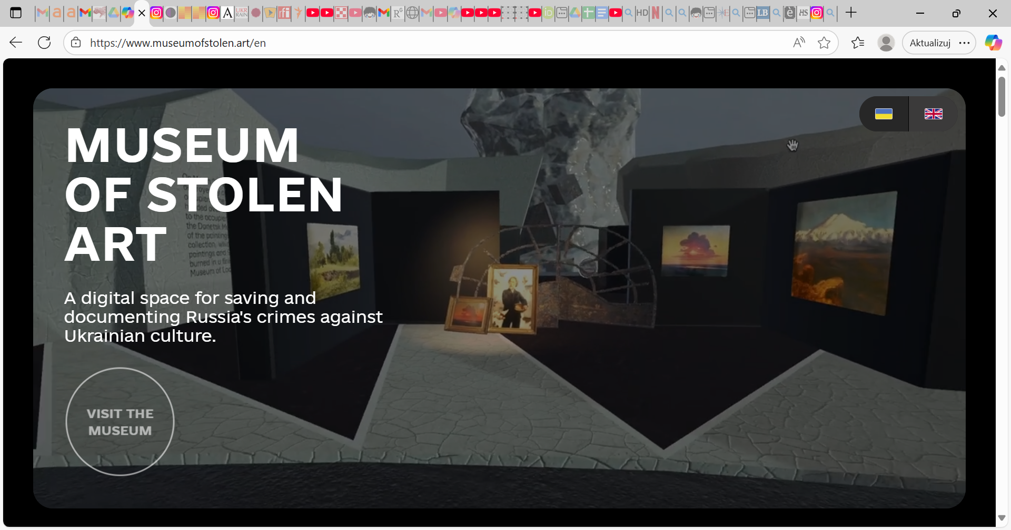

Slide 9
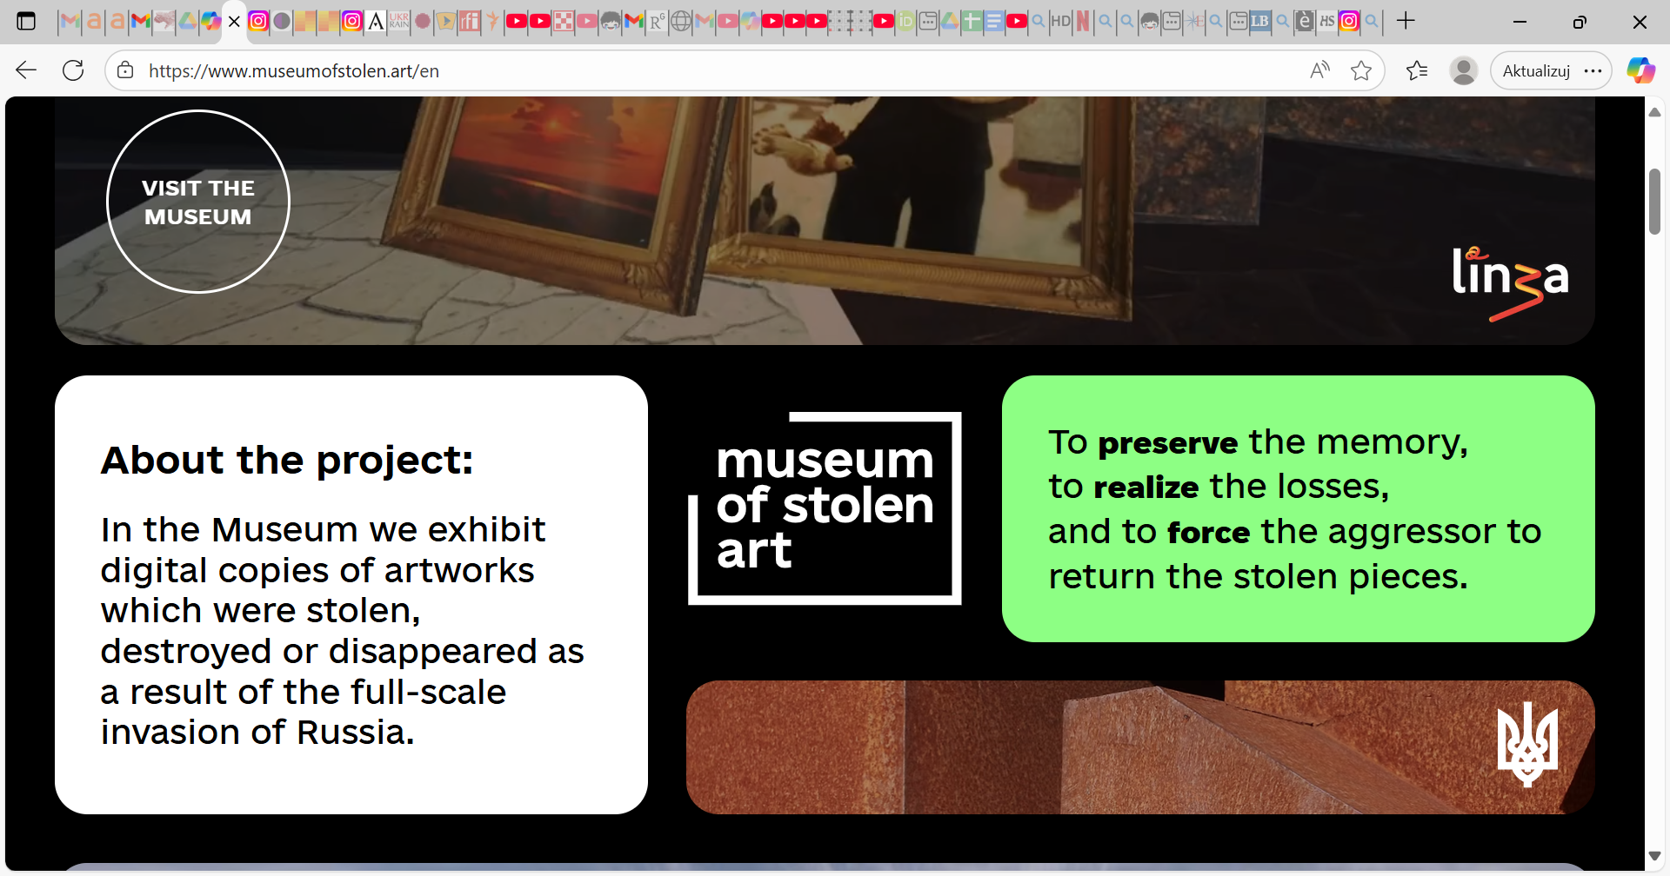

Slide 10
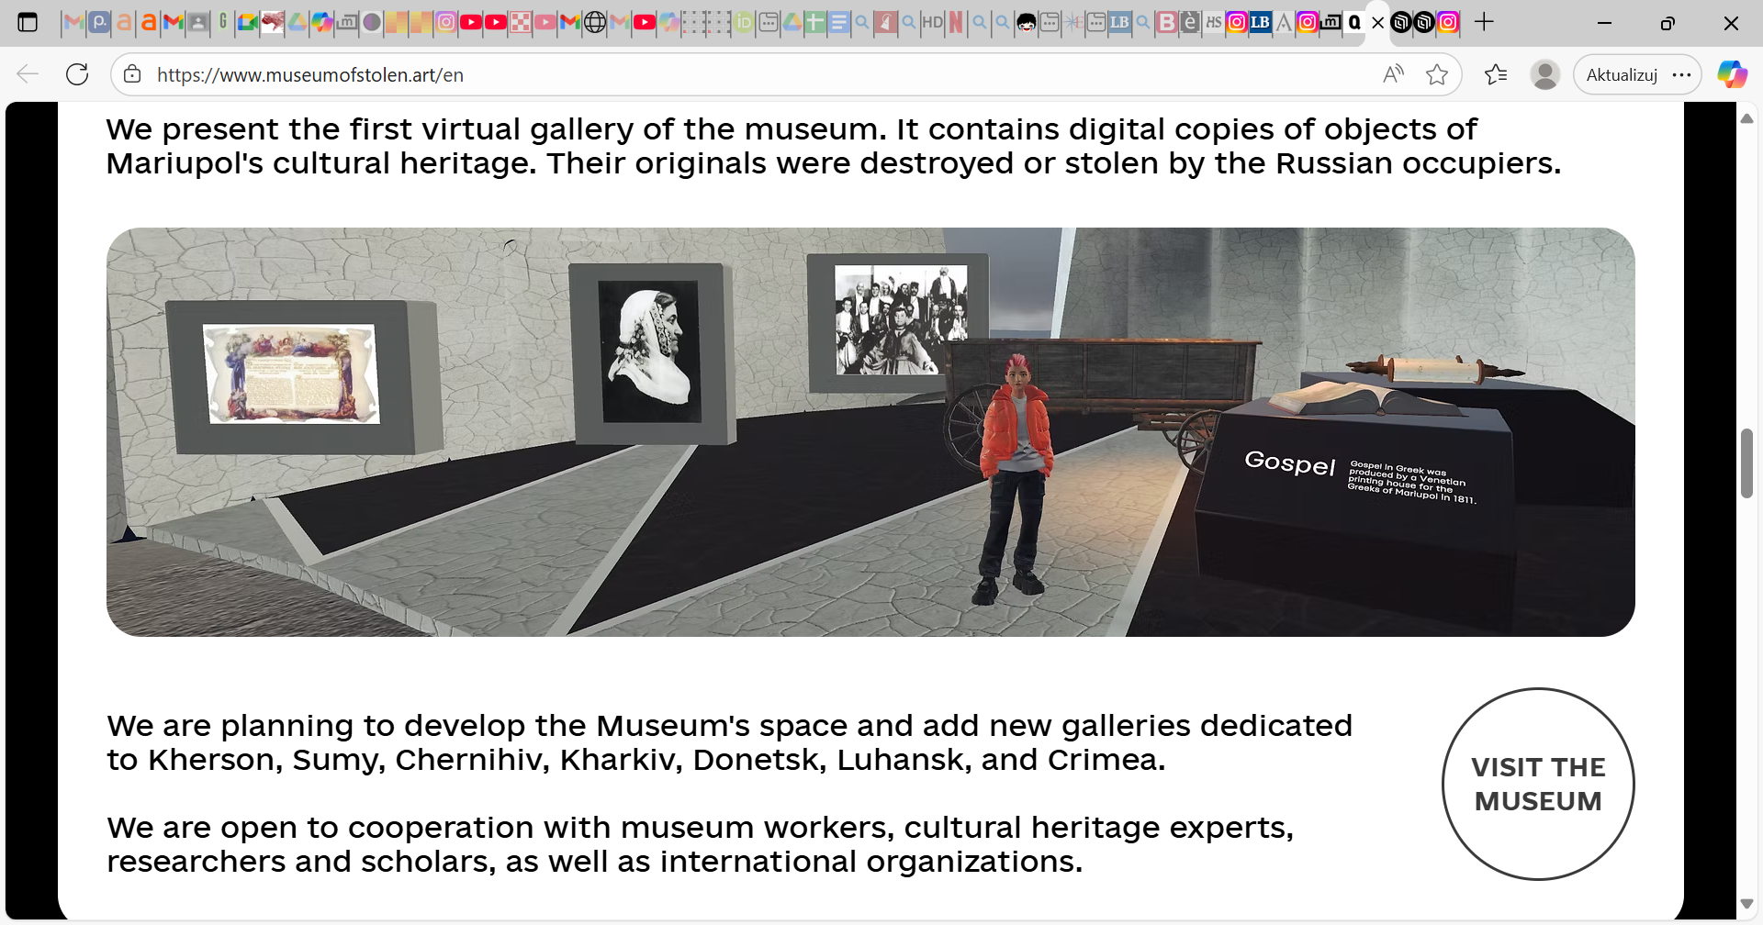

Slide 11
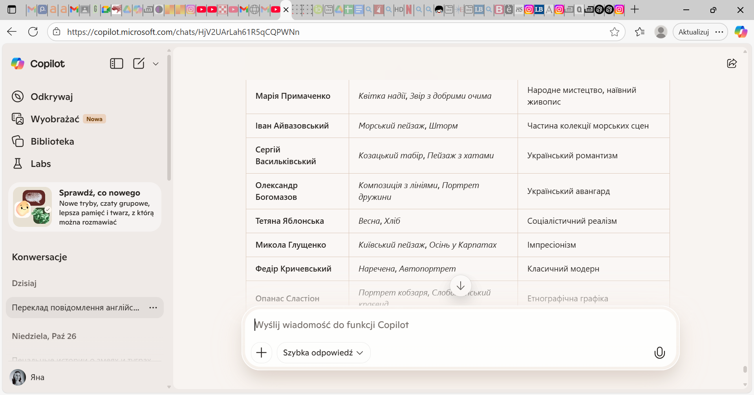
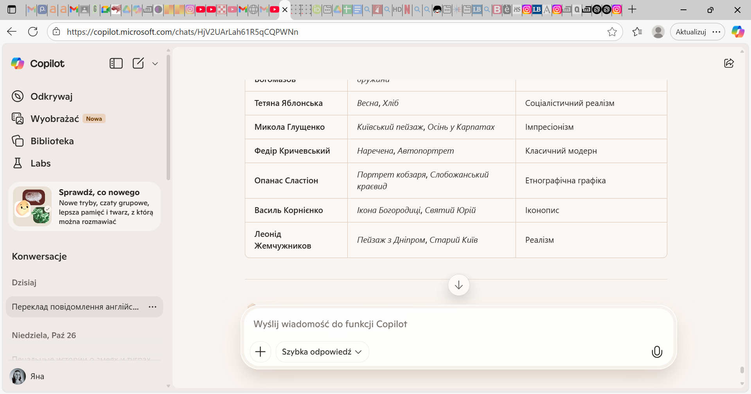
1233 stolen artworks
Kherson Regional Art Gallery named after
O.Shovkunenko

Slide 12
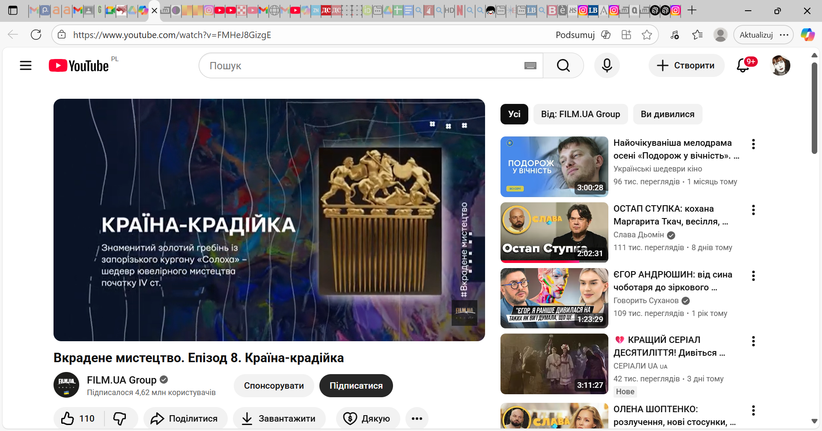
https://youtu.be/FMHeJ8GizgE?si=bCN_pzO1ffkyPZLi

Slide 13
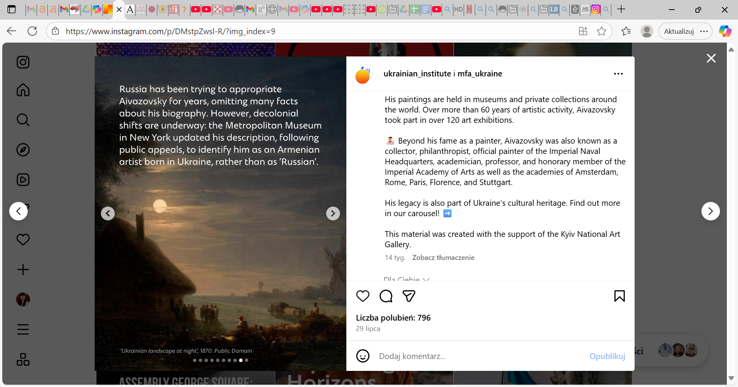
https://www.instagram.com/p/DMstpZwsl-R/?utm_source=ig_web_copy_link&igsh=MzRlODBiNWFlZA==

Slide 14
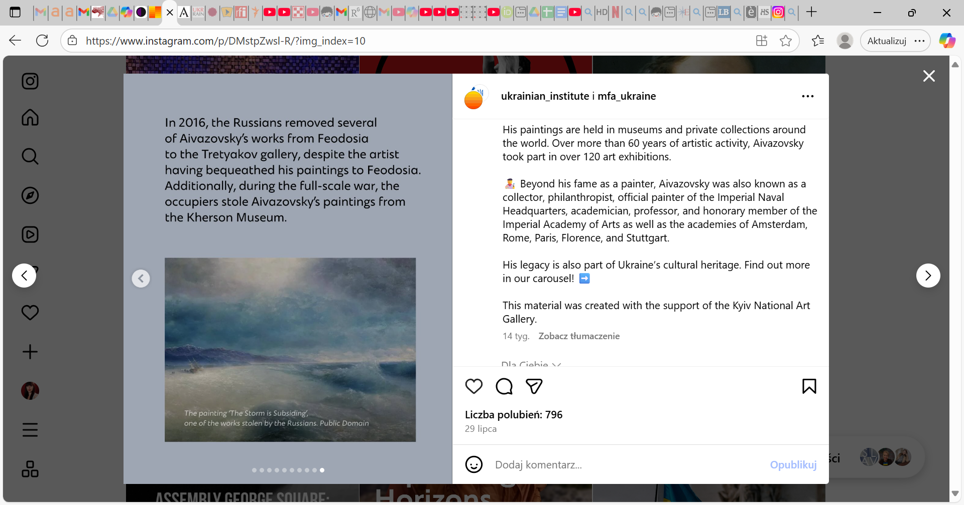

Slide 15
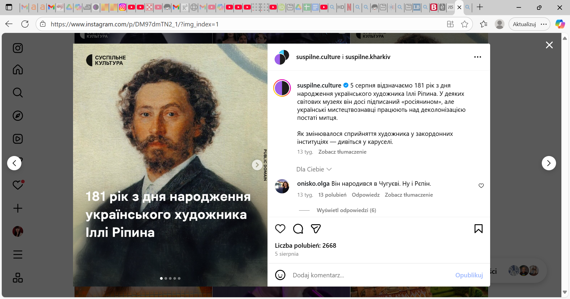
https://www.instagram.com/p/DM97dmTN2_1/?utm_source=ig_web_copy_link&igsh=MzRlODBiNWFlZA==

Slide 16
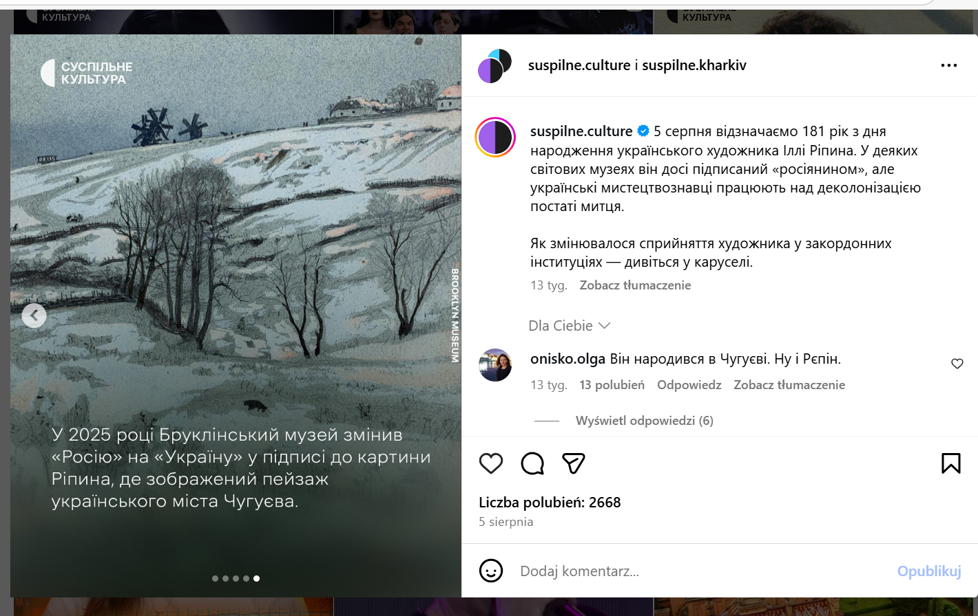
In 2025, the Brooklyn Museum updated the label for his painting - changing “Russia” to “Ukraine”. The artwork shows a landscape from Chuhuiv, a town in Ukraine.

Slide 17

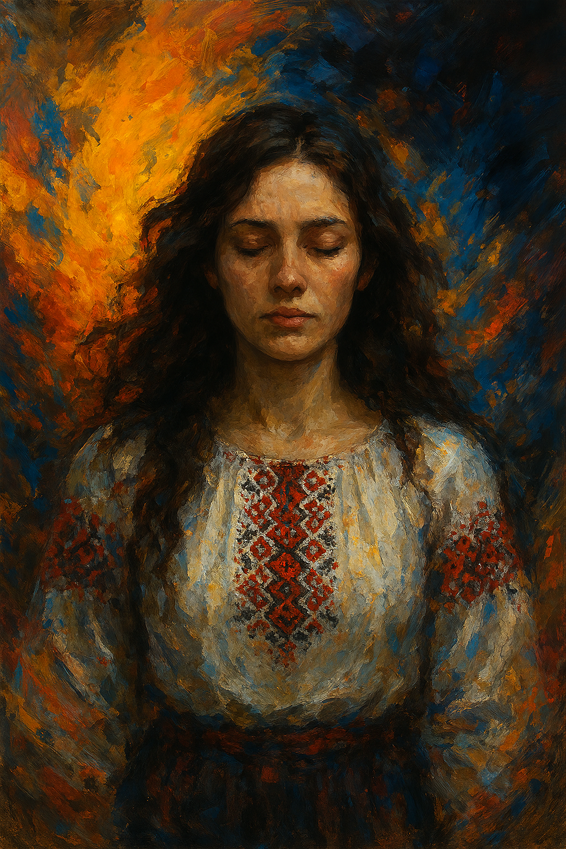
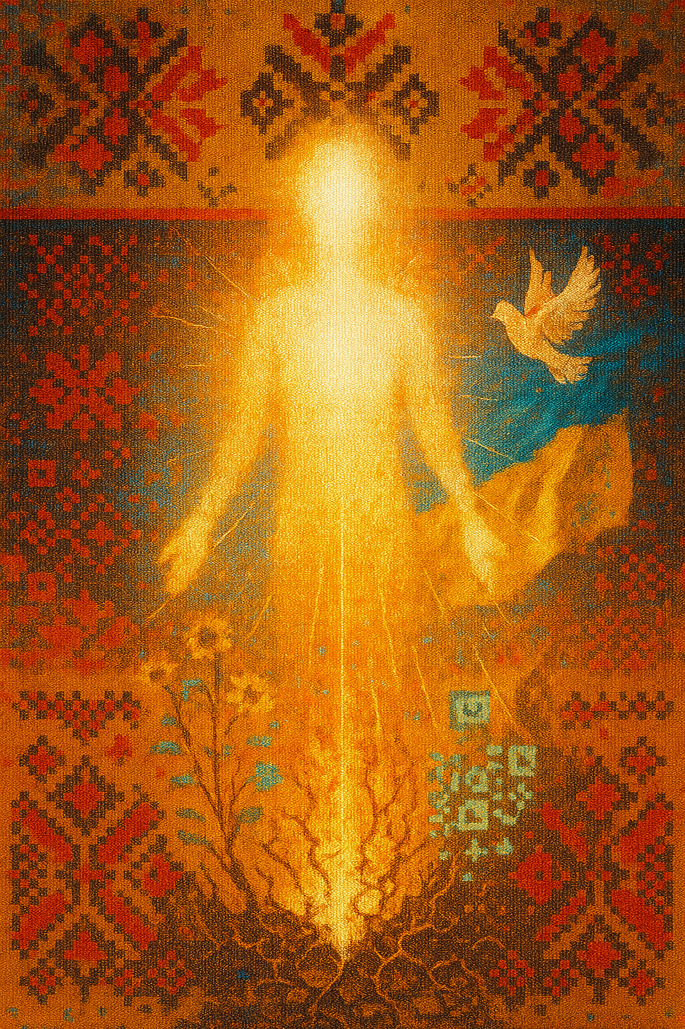
This presentation is part of the grant project “MINIATURA 9,” funded by the National Science Centre (Poland): “Born of Shocks: Catharsis of Ukrainian Art in Cultural Media Content (2022–2025)”, conducted by the author at the Institute of Slavic Studies, Polish Academy of Sciences.

